Slide 1


The Ectopic Pregnancy Trust
Raising awareness of ectopic pregnancy
Notes:
Emotive topic. We do not know about everyone’s individual experiences. If need a moment away, that is of course fine. Take a break and return when able.

Slide 2
Today, I’ll be talking about…
What is an ectopic pregnancy
What does The EPT do
How you can help

Slide 3
Why everyone should know about ectopic pregnancy
Type of pregnancy loss which can be life-threatening for woman/pregnant person
Common: Affects around 1 in 80 pregnancies; 12,000 diagnosed in UK annually (anecdotally 30,000)
Yet awareness still much-needed
Physically and emotionally demanding
Notes:
“Ectopic pregnancy” remains relatively unknown.
Not hierarchy, all types of pregnancy loss devastating in uniquely upsetting ways. Highlighting awareness needed and not be hidden type of pregnancy loss.
Those of us who experience it to be seen and issues talked about. That is why here today and thank you for wanting to shine a light on this vital topic.

Slide 4
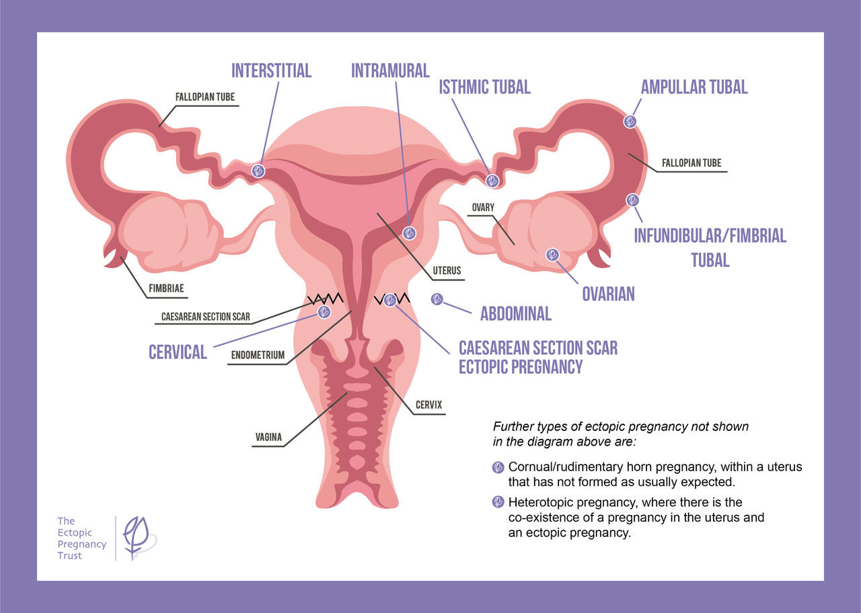
Notes:
EP occurs when a pregnancy implants in a location that is not inside the space of uterus.
Most common location along a Fallopian tube – circled in diagram. Around 95% in a Fallopian tube.
There continues to grow and can cause rupture, resulting in internal bleeding.
Often emergency situation.

Slide 5
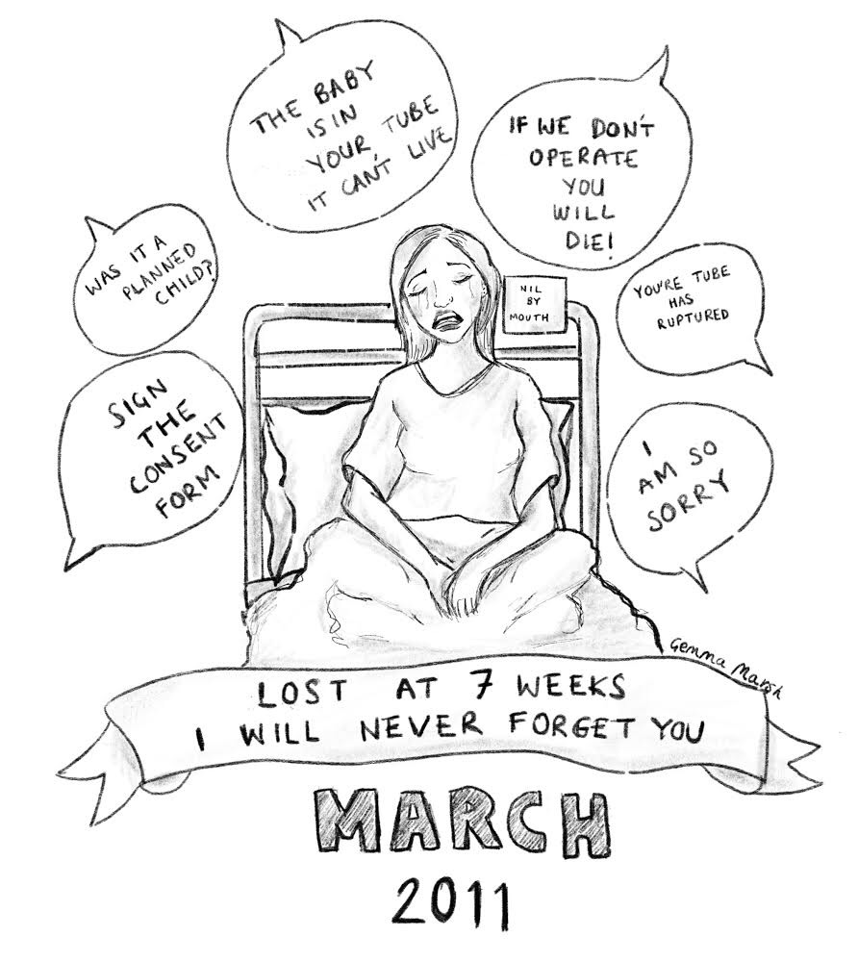
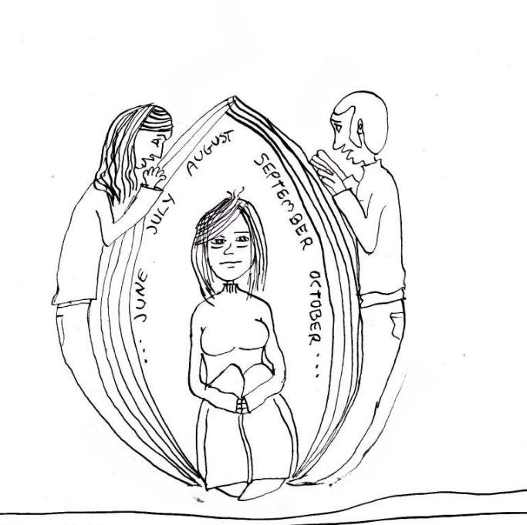
Ectopic pregnancy has many impacts, both physically and emotionally
Notes:
Can talk about some of the physical and emotional impacts you as an individual personally experienced.
Content can include what you feel comfortable about sharing about your experience eg: what symptoms you had, your diagnosis, the treatment you had, how you physically and emotionally felt, what it was like going back to work

Slide 6


…feel like an imposter as my losses were caught so early, or because they weren’t really natural losses but they had to be surgically removed out of me.

Slide 7
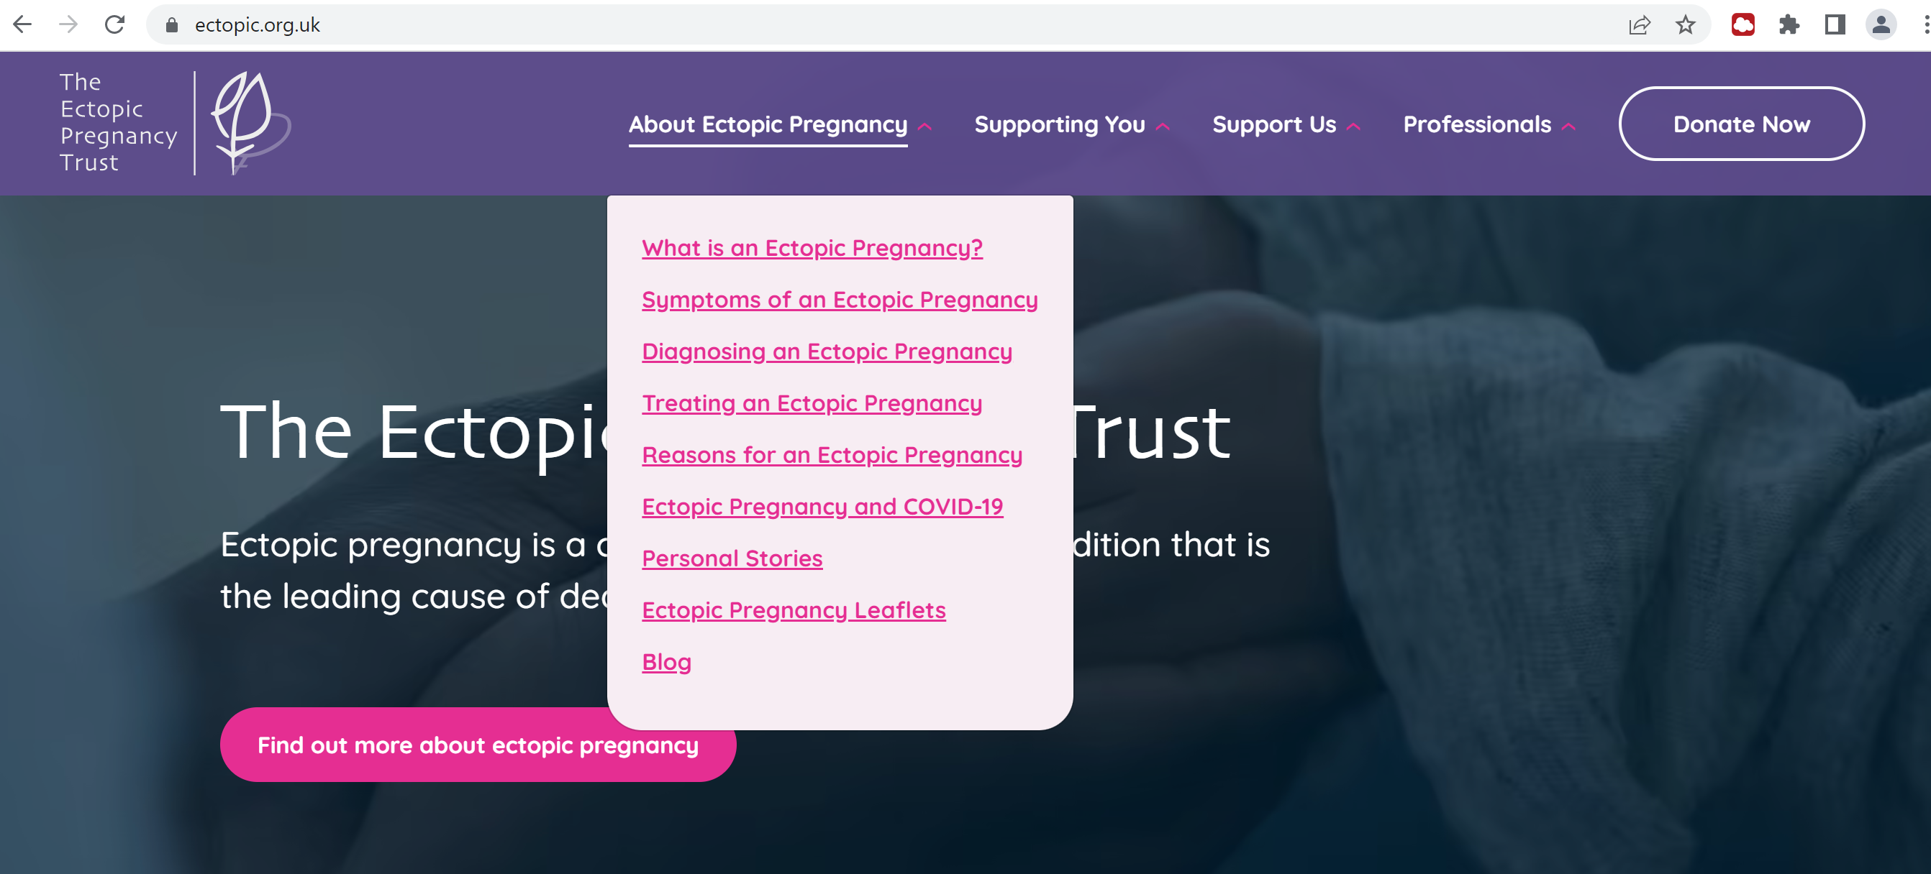

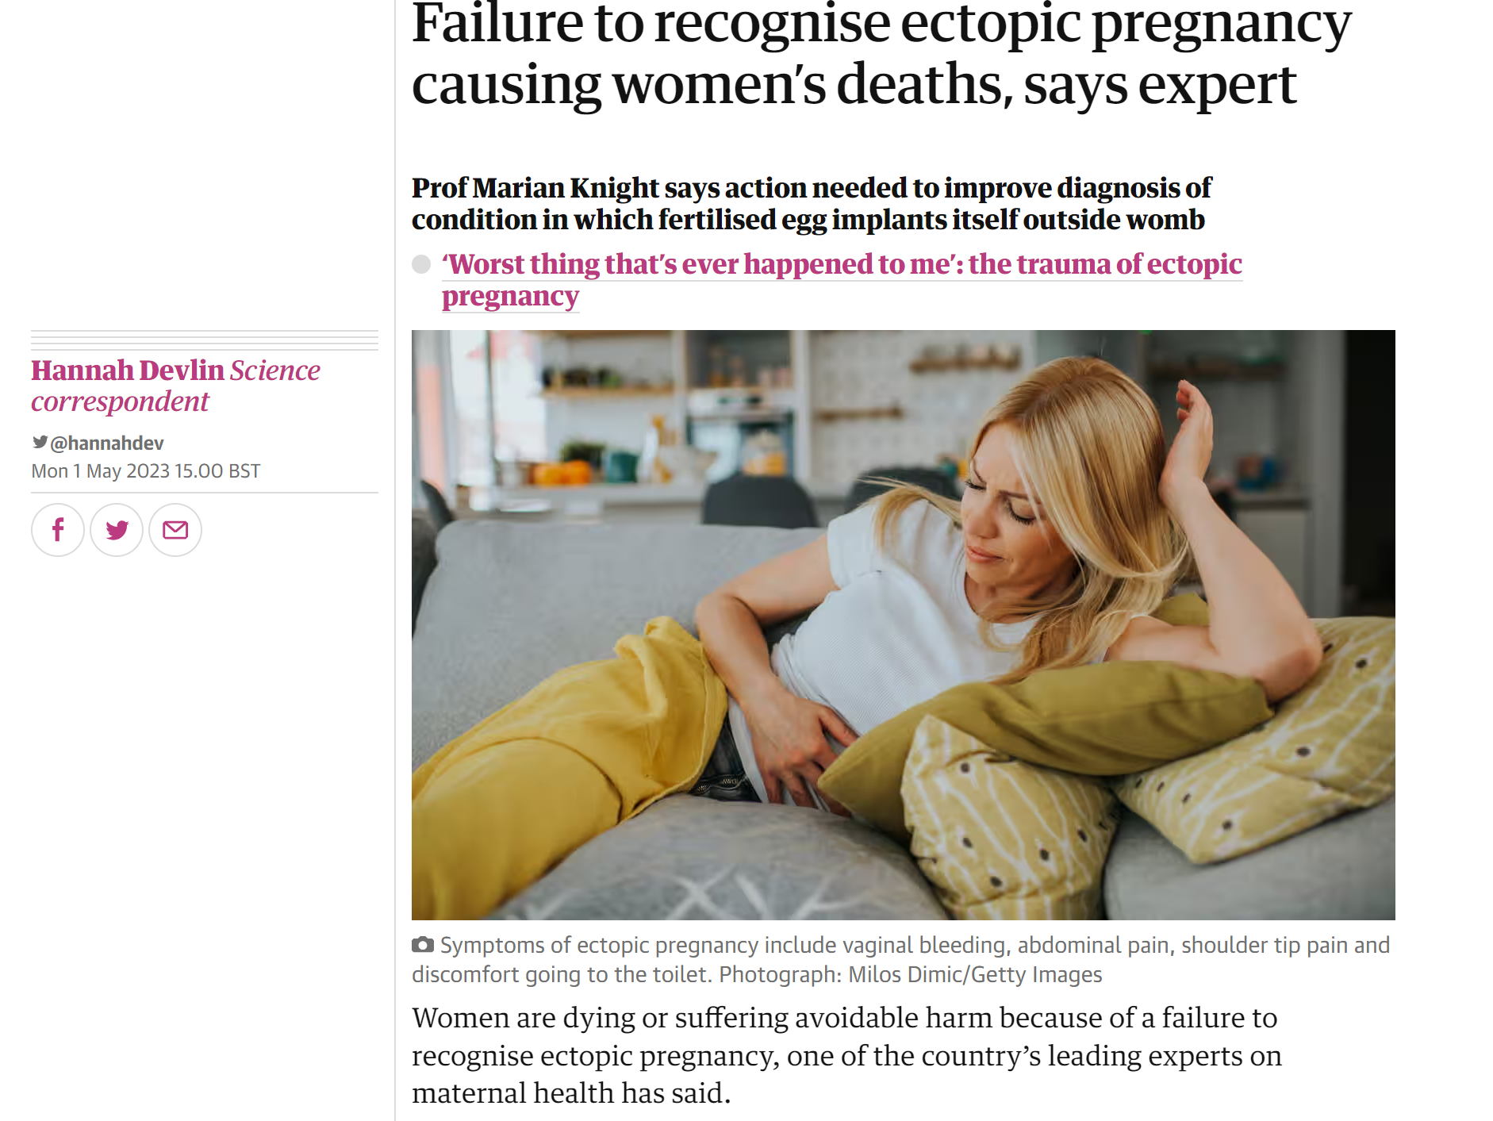
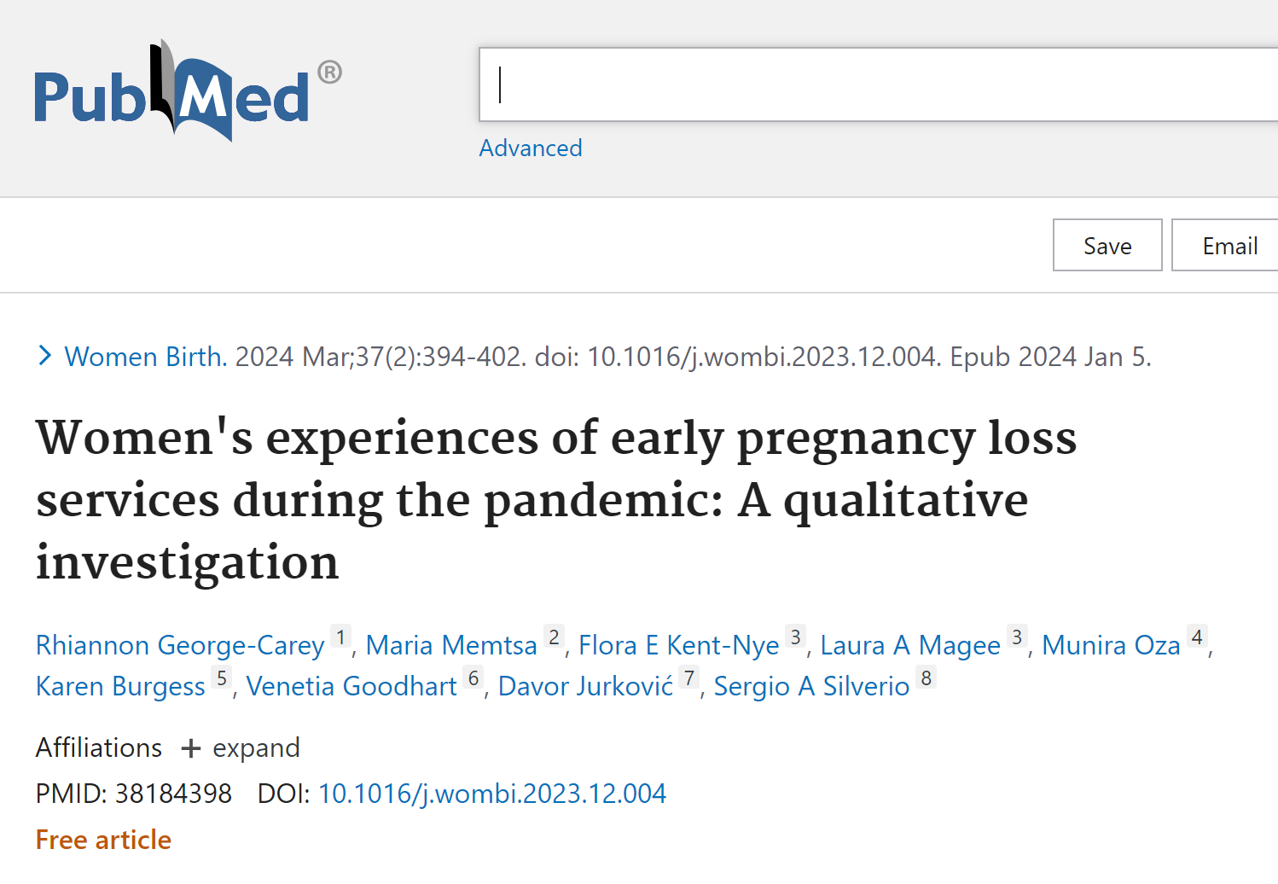
What The EPT does
Information and support
Education and awareness
Research
Notes:
World leading charity focused on ectopic pregnancy
Trusted by NHS and healthcare professionals – signposted on the NHS website
Provide free leaflets to hospitals across the UK for doctors to hand to their patients

Slide 8
How you can help
I am fundraising for The EPT by… [Fundraiser describe activity]
[Fundraiser to add donation page link and QR code]
[Option to include photo in EPT tshirt]

Slide 9

Thank you for your support!
With your help, The EPT can continue their crucial work for another 25 years… and beyond!
ectopic.org.uk

